Slide 1
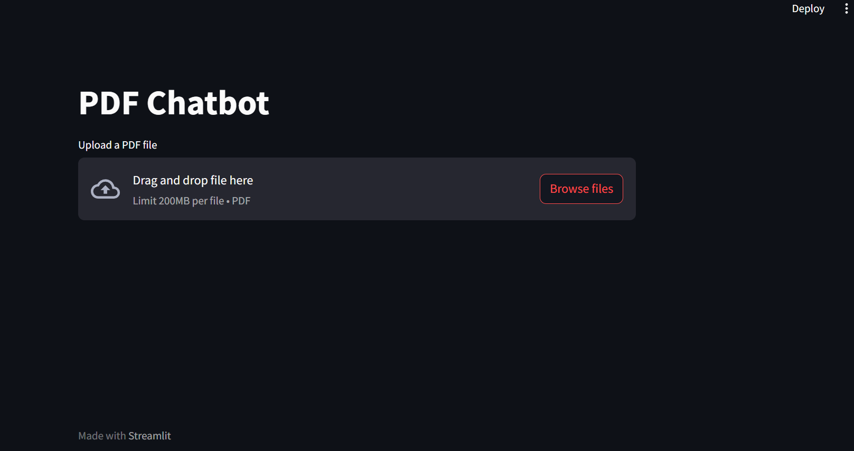
PDF
CHATBOT
SoC’24

Slide 2
Agenda
Jun 20 – Jun 26
Jun 26 – Jul 02
Jul 02- Jul 14
Jul 14- Jul 20
Jul 20- Jul 26
01
02
03
04
05
Python Basics
Learn basics of python and libraries used in ML and NLP.
NLP Basics
Chat with data
Streamlit
Miscellaneous
Learn basics of NLP techniques. Understand word embedding and similarity search.
Introduction to langchain library and understand how to create a chatbot trained on any pdf using OpenAI api key and Langchain.
Learn basics of streamlit. Create an interface for chatbot.
Report making, other improvements in the chatbot etc.

Slide 3
WEEK 1
Python BASICS:
https://www.w3schools.com/python/python_intro.asp
(you can also refer to YouTube videos or any other resources)

Slide 4
WEEK 2
NLP BASICS:
https://www.youtube.com/watch?v=zlUpTlaxAKI&list=PLKnIA16_RmvZo7fp5kkIth6nRTeQQsjfX
(You can refer to other resources available online as well)
Word embedding basics:
https://youtu.be/jN08NAD_-Ws?si=fO--oPvwRFL-R9Xv
Similarity search basics:
https://youtu.be/e9U0QAFbfLI?si=MQT7tBLlC8JaSmv_

Slide 5
WEEK 3 to 4
What is Langchain:
https://youtu.be/5YHrnLoKn_w?si=DWu-wrQkiodpMYcV
Getting started with the basics of langchain:
https://youtu.be/aywZrzNaKjs?si=3WWsHE4ssScUi3tG
(You can refer to other resources available online as well)
Create Chatbot: Create a chatbot which is capable of answering any questions related to the pdf.
https://learn.deeplearning.ai/langchain-chat-with-your-data/lesson/1/introduction

Slide 6
WEEK 5
Create Chatbot: Create a chatbot which is capable of answering any questions related to the pdf
https://learn.deeplearning.ai/langchain-chat-with-your-data/lesson/1/introduction
Develop a web interface for the chatbot using streamlit:
https://www.datacamp.com/tutorial/streamlit
https://youtu.be/_FpT1cwcSLg?si=C1CcBk4NaDNOev10
(You can refer to other resources available online as well)

Slide 7
WEEK 6
Miscellaneous
Report making, other improvements in the chatbot etc.

Slide 8
THANK YOU

